Slide 1
Human and machine translation testing for parity
Updated in 2025 from a presentation given in Seoul, Korea, July, 2019, at APTIF9

Slide 2
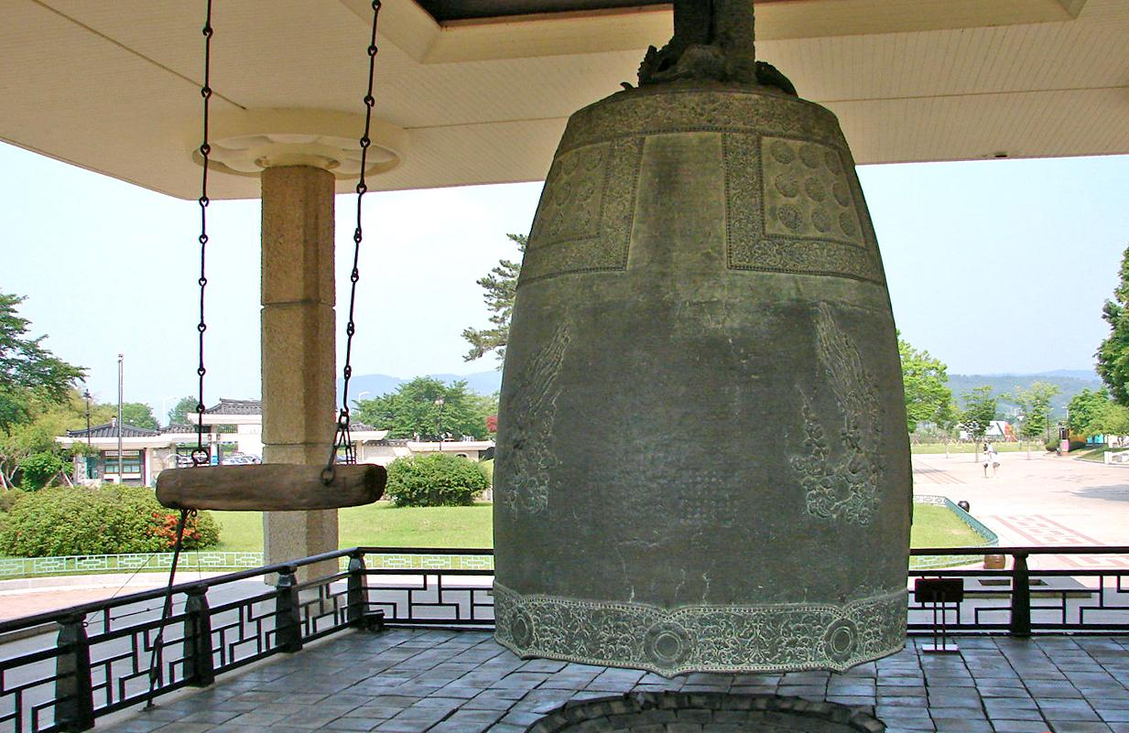
Bell of King Seongdeok aka Emile Bell credit: Wikimedia author: Steve46814

Slide 3
Bells AUTOMATIC translation will have to ring to be like human translation
Alan K. Melby, CT
Was Vice-president of FIT in July 2019
Now (June 2025) Chair of FIT North America

Slide 4
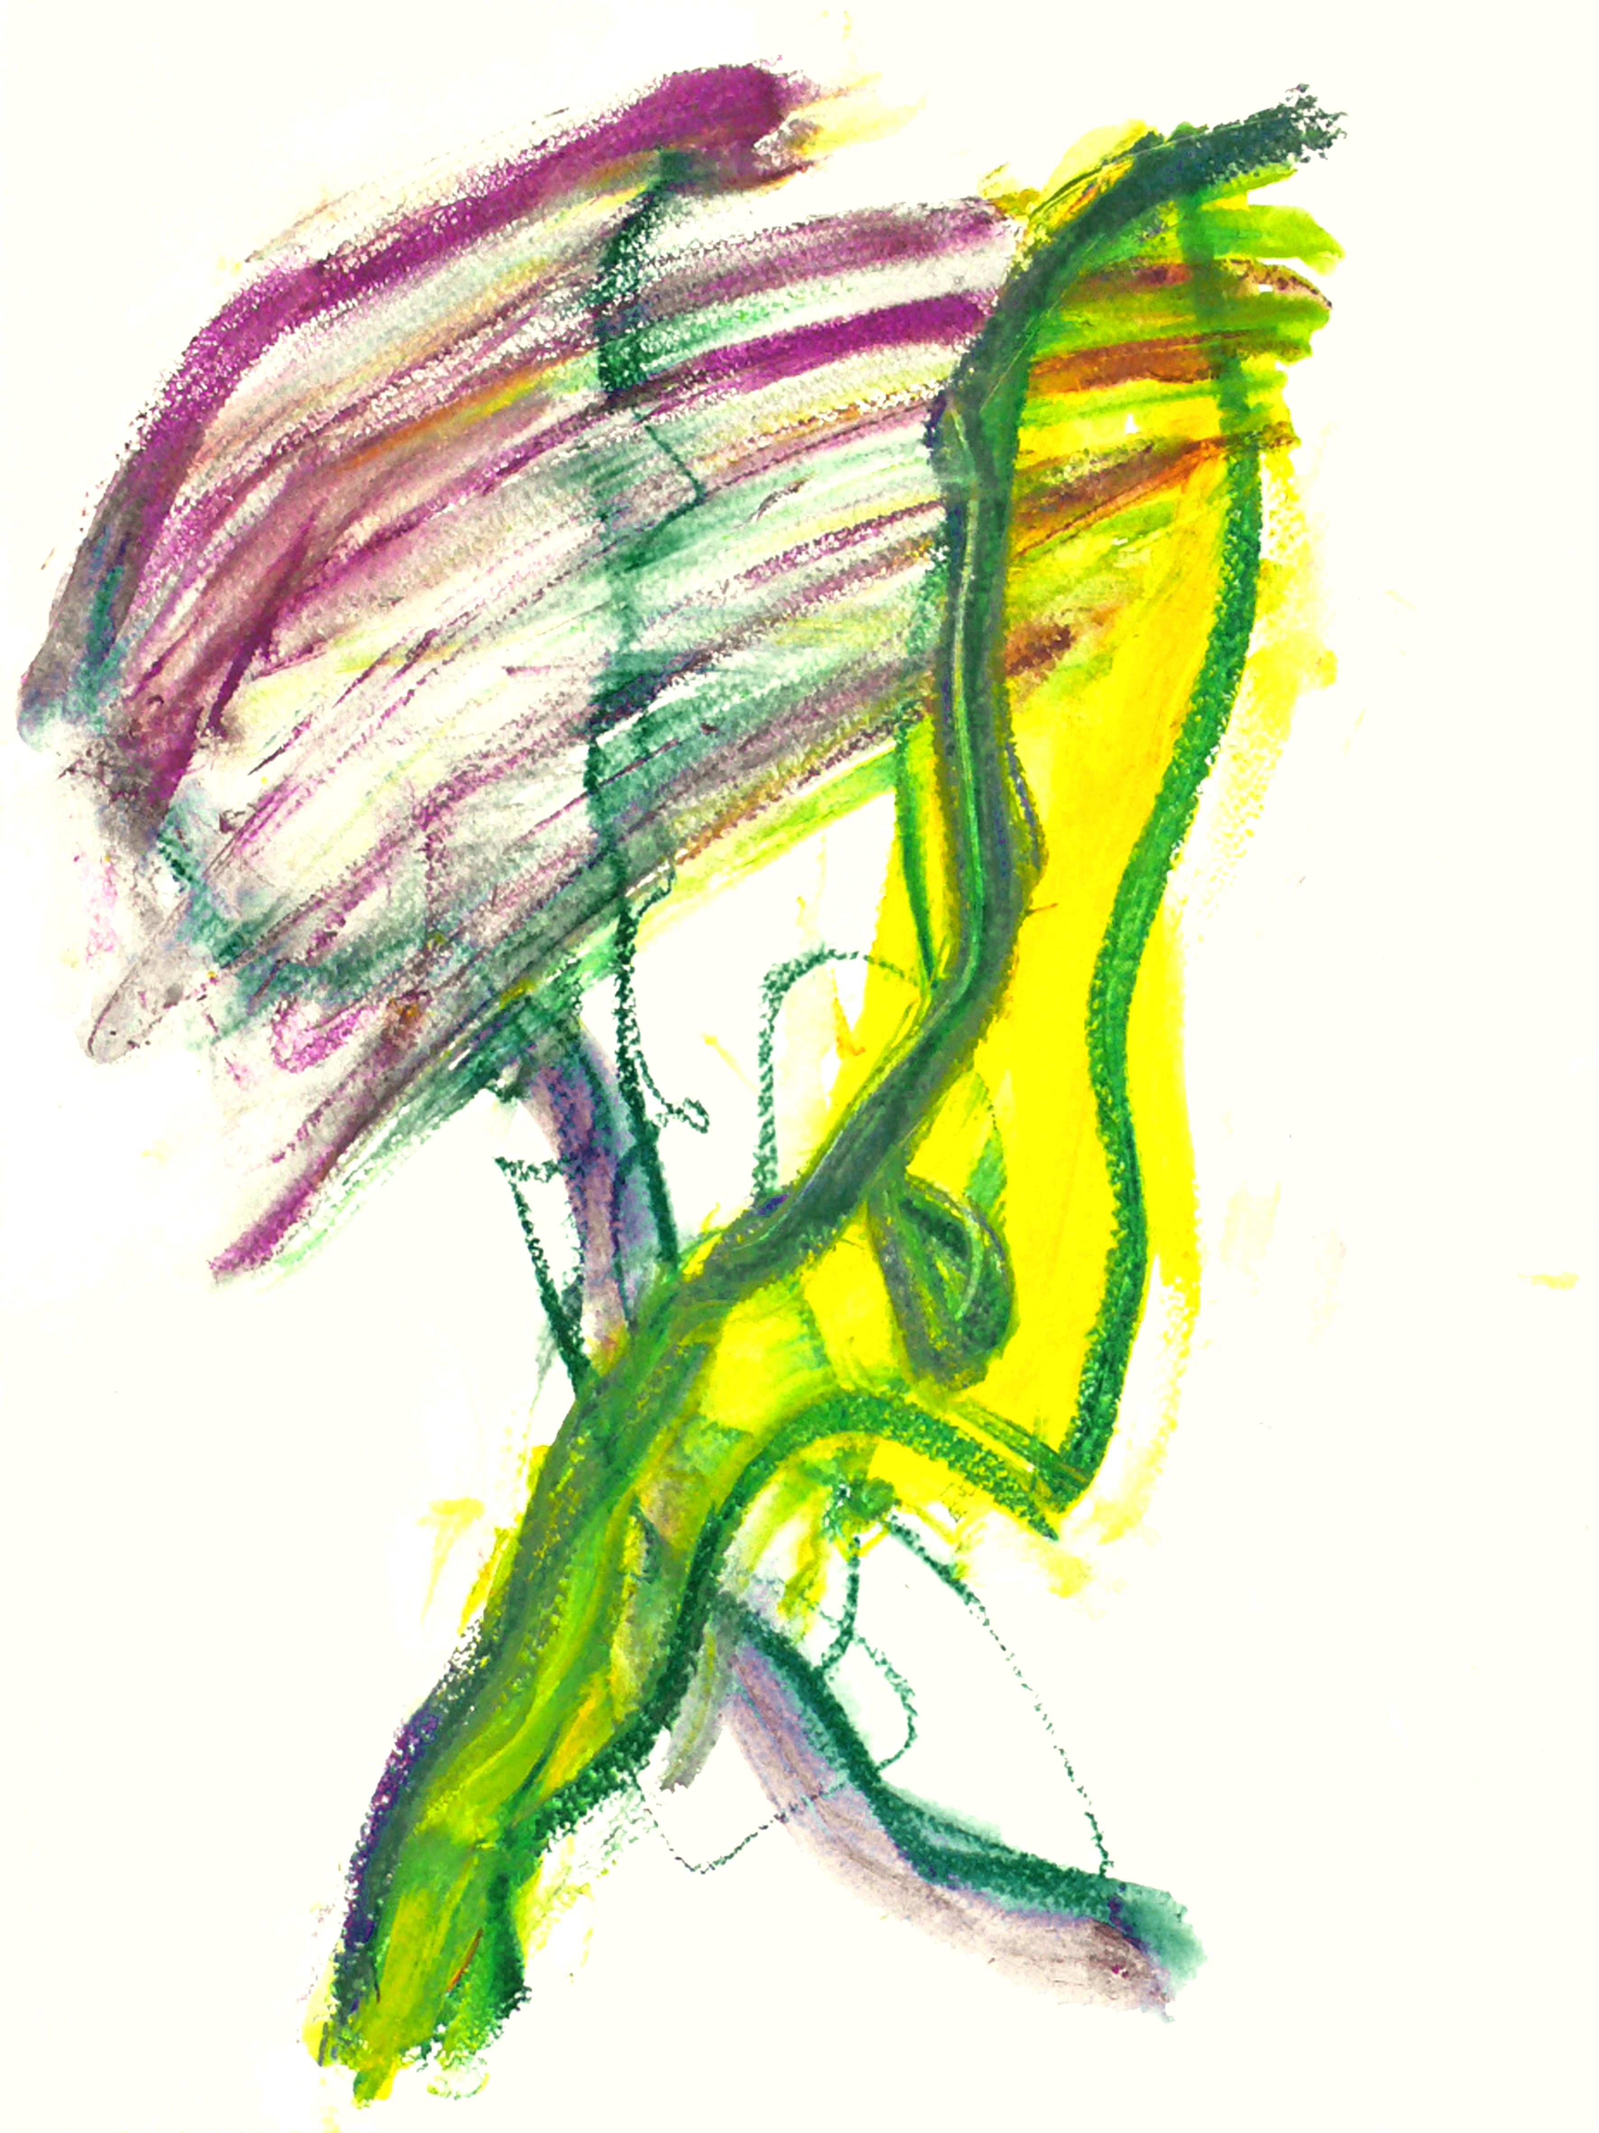

Slide 5
Abstract
[Background for newbies: We are now in the third generation of machine translation systems. The first was rule-based (RBMT), the second was phrase-based statistical (PBSMT), and the current generation is based on “neural” networks (NMT).]
Claims are being made that the need for professional human translators will soon disappear, because machine translation has achieved “parity” with human translation.
This presentation will describe a practical way to respond to these claims, based on what translation service providers (TSPs) do every day when they interact with a requester and metaphorically ring three “bells”.
We need risk analysis, labels, and augmentation of humans.

Slide 6
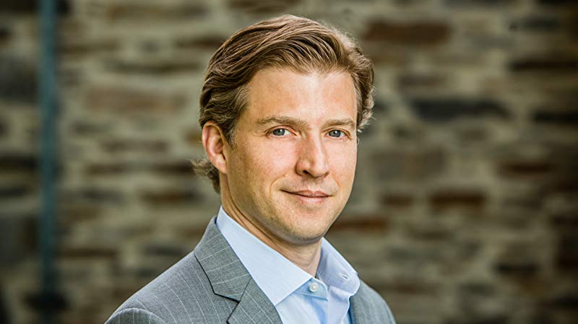

Slide 7
Some High-Profile Claims about Machine Translation
Alec Ross, in his New York Times best selling book, Industries of the Future, published by Simon & Schuster in 2016, claimed that the profession (human translator) will mostly disappear within ten years (that is, by 2026) because translators will be replaced by machine translation.
Microsoft, in March 2018, stated “We find that our latest neural machine translation system has reached a new state-of-the-art, and that the translation quality is at human parity when compared to professional human translators.”
Therefore, this presentation begins with a proposed definition of translation quality consistent with how quality is defined in ISO 9000.

Slide 8
Definition of Translation Quality
A quality translation demonstrates correspondence and fluency required for the audience and purpose and complies with all other specifications negotiated between the requester and provider, taking into account requester and end-user needs.

Slide 9
correspondence is about comparing source and target
(correspondence includes both accuracy and terminology)

Slide 10
Fluency is only about the target text
Is it grammatical? Is it spelled correctly?
Regardless of whether it corresponds to the source text

Slide 11
Specifications should be based on standardized translation parameters
ASTM International (www.astm.org) publishes F2575; ISO (www.iso.org) publishes 11669 . The translation parameters in them are compatible.

Slide 12
Stakeholders: requester, provider, and end user
The publisher is the party that makes a target text available to end users. In many situations, end users of a translation can be viewed as “consumers”.

Slide 13
A Professionally Verified Translation is fluent, corresponds appropriately to the source, and meets all other specifications
In the age of machine translation, most translation produced and used on a given day is raw automatic translation (NMT, from GenAI, etc) and should be labeled as such
Both automatic translation and translation by non-qualified humans should be labeled as Un-Verified Translation

Slide 14

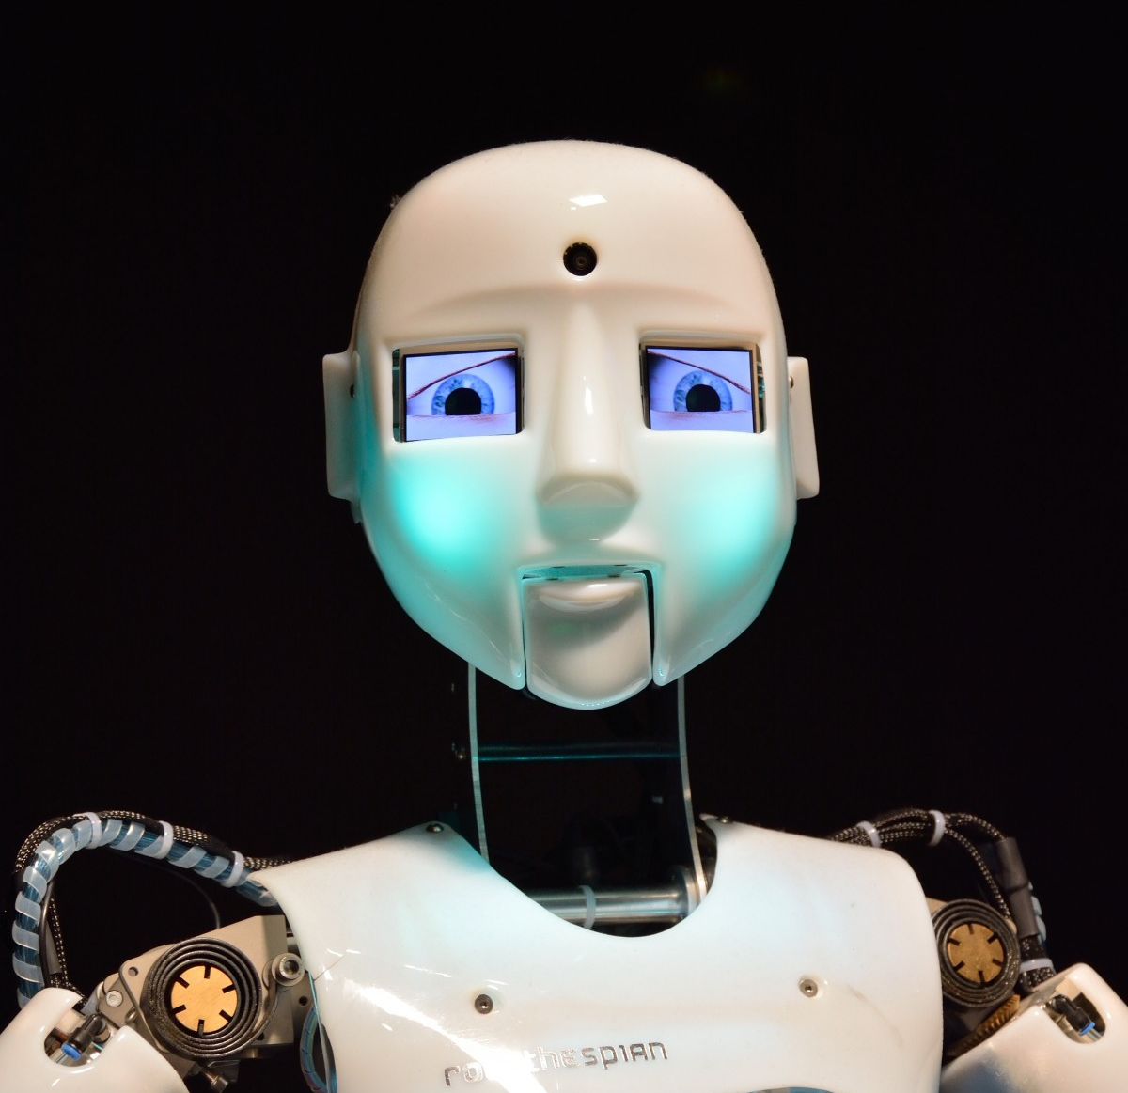
Jost Zetzsche

Slide 15
Spectrum from MT to HT (methods of production)
(1) Raw (unedited) Automatic Translation = Raw MT
(2) Full-text PEMT (not translation, editing a machine-translated text, referring back to the source to check for correspondence)
HT (human translation, from the source text):
(3) Modern HT often provides the option of MT as a resource to the human translator as he or she translates from source text
(4) Classic HT, which is becoming obsolete, allows terminology lookup and translation memory lookup but no access to MT
As of 2025, there is still work for professional human translators
However, this still leaves open the claim of raw MT achieving parity with HT – Has it happened for some use cases?

Slide 16


Slide 17
Big Question about Translation
How well do you need to understand the source text in order to produce a quality translation outside a narrow domain --- better than MT “understands” the source?
Note: To convert to Morse Code you do not need to understand the source text at all. What about translation?

Slide 18
Facts
To learn a language, humans require “comprehensible input” (Krashen)
Language acquisition experts debate how to tell when language-learning input is sufficiently comprehensible
MT is entirely dependent on HT data

Slide 19
Question
Do machines understand what they are translating?
Answers vary widely
Thus: Do not waste time trying to define understanding; instead find a practical test of parity claims that does NOT require understanding to be formally defined.

Slide 20
How can we clarify the relationship between human and machine translation without endless debate?
One approach:
Use the Translation Turing Test. It does NOT require consensus on whether understanding is necessary for quality translation or whether machines can understand; it compares the requester experience between two types of TSP

Slide 21
the TTT (Translation Turing Test) Can the requester tell whether a human translator is involved?
To determine whether there is parity between human+MT and MT-only TSPs
(first proposed by AKM in 2012)

Slide 22


Slide 23
What is MQM?
Multidimensional Quality Metrics
A forthcoming ASTM standard (project ID WK46396), compatible with ISO 5060
From the draft scope:
This standard provides a framework for analytic evaluation of the quality of translation products, with a focus on the identification of specific translation errors, within the context of a quality management system compatible with the principles of ISO 9000. This standard allows implementers to generate quality scores for how well a given translation product meets translation specifications based on the translation parameters in ASTM F2575.

Slide 24
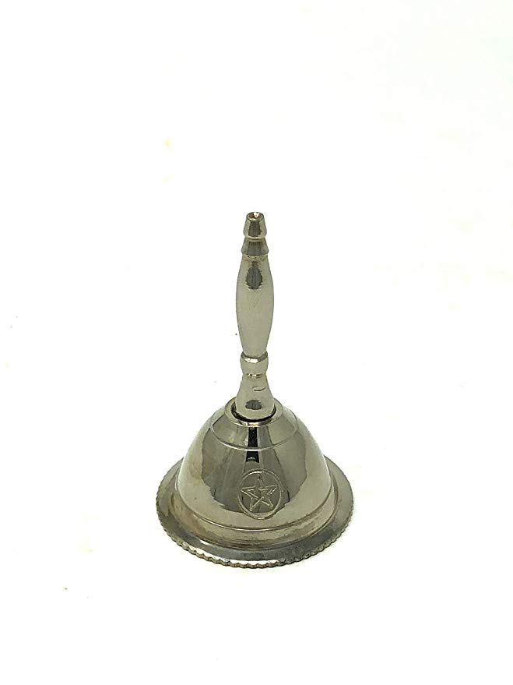
Three Bells to Ring Ring first bell by providing a translation that takes specifications into account

Slide 25
Task 1: Each TSP delivers a translation that TAKES IN ACCOUNT THE given set of F2575-conformant specifications
Within the overlap between the stated skill sets of the human+MT TSP and the MT-only TSP

Slide 26
Ring second bell by correcting errors based on evaluation or by debating the evaluation

Slide 27
Task 2: (AFTER A third party Conducts an analytic translation quality evaluation using MQM)
Each TSP either accepts the evaluation and produces a corrected translation, if needed, or debates with the evaluator (in a language used by both TSPs).
Bonus: be able to discuss three linguistic levels (syntax [grammatical errors], semantics [mistranslations], and pragmatics [eg aspects of a translation relating to target language and culture])

Slide 28
Ring the third bell with a quality alternative translation of the same source text but for different specifications.

Slide 29
Task 3: Given same source text and different specifications, Produce an alternative translation that meets the new specifications
The alternative translation is also evaluated using MQM. For more information on F2575 and MQM, see www.tranquality.info and www.themqm.org

Slide 30
Please note that the Translation Turing Test of parity does not require us to decide whether machines understand what they are translating.
It only requires that they can perform the same three tasks any professional TSP (translation service provider) should be able to perform:
Translate according to specifications
Respond to a quality evaluation
Adjust when the specifications change

Slide 31
What is your position on two key questions?
Has machine translation achieved parity with human translation, that is, has it rung the “parity bell” for each task in a TTT?
While preparing for the MT Summit 2025 tutorial, a team conducted a TTT to find out for one use case.
What is a better question than when machine translation will replace human translators?
My position: How to identify use cases when Professionally Verified Translation is needed. Also, how to augment human translators in those cases.

Slide 32


Slide 33
How can humans rise above the claims of parity and ring the bells MT has not?
Become risk-management advisors on whether Professionally Verified Translation is needed or Un-Verified Translation is sufficient for a use case; focus on translation projects with specifications that include:
High-value content (where translation mistakes matter)
High-level content (where sentences cannot be translated in isolation and impact matters)
High-expertise content (where in-depth subject-matter knowledge matters)

Slide 34
Thank you! Now, enjoy the chaos of the age of AI and check the results of a TTT.
Questions?
Comments:
alan.melby@fit-ift.org
First item in subject line:
TTT
Website: www.ttt.org

