Slide 1
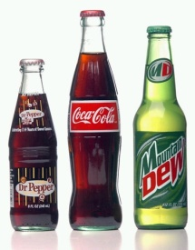
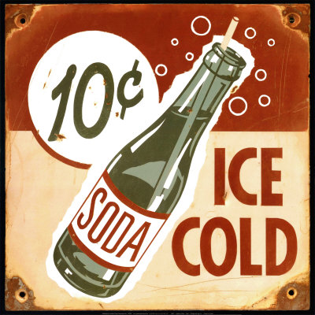
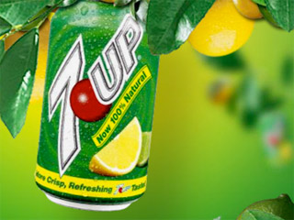
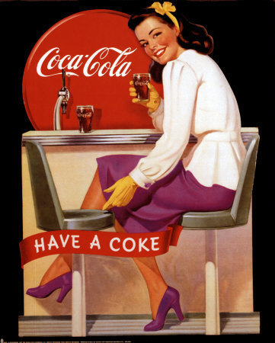
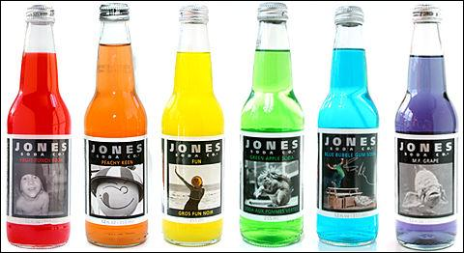
Is “Pop” More Popular?
Answering the question of the geographic range of generic names for soft drinks in the United States.

Slide 2
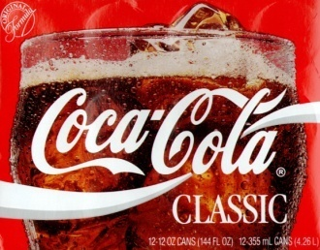
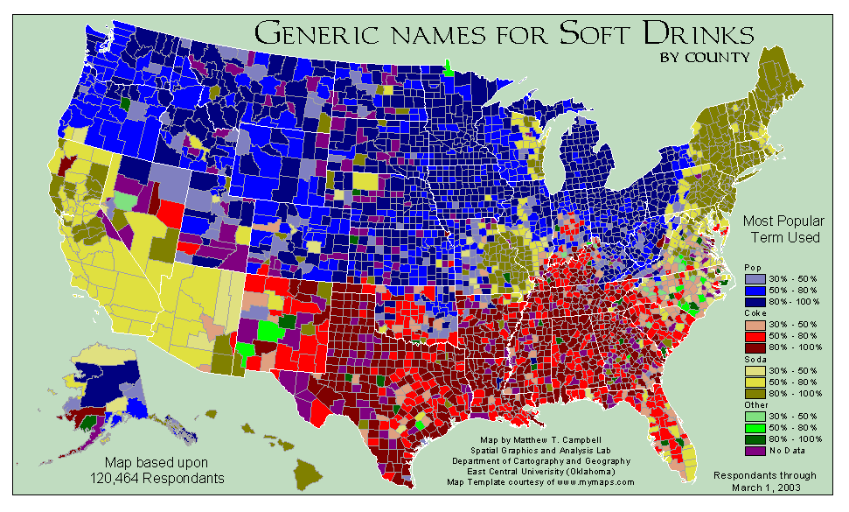
Map

Slide 3
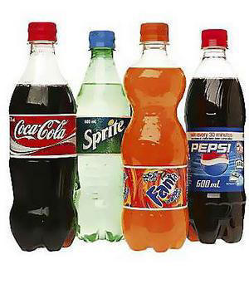
Methodology
Goal: To find out if “pop” is the most geographically wide-spread generic name for a soft drink.
Method: Look which term has a physically larger range in each state. Each state is placed in the “pop” or “other” category. Finally, add the area in square miles of all states in either category together. The term with the largest area is the term that is most wide-spread.

Slide 4
Map

Slide 5
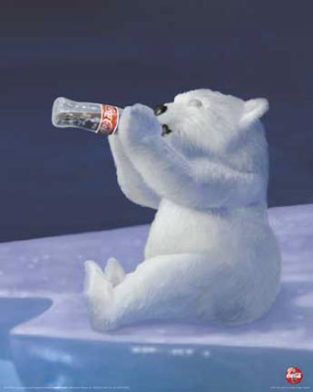
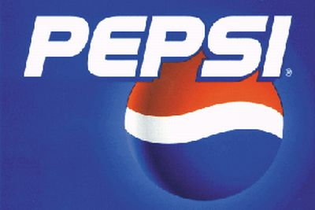
Results
Pop
1,936,515.74 square miles
Other
1,600,861.30 square miles
Difference of 335,654.44 square miles

Slide 6
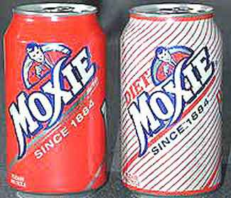
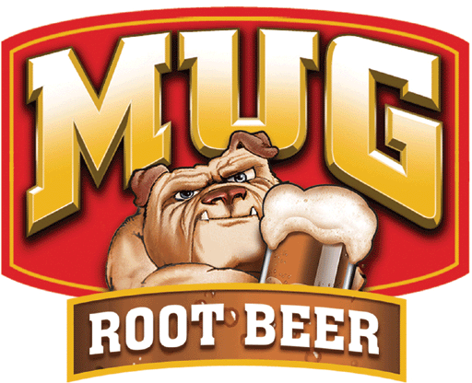
results
In the contiguous United States, “other” beats “pop” by 229,873.80 square miles.
In the “other” category, Coke is more widely used than “soda” by 31,725.41 square miles. “Soda” has the smallest range out of all three major terms.

Slide 7
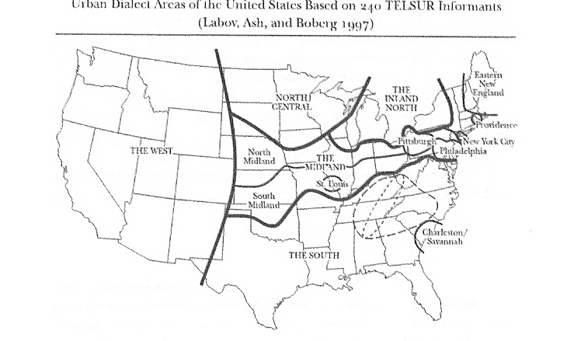
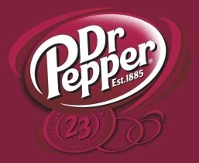
Analysis

Slide 8
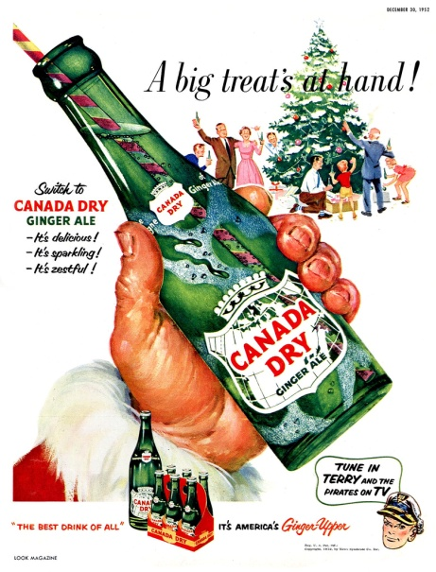
Analysis
From the Oxford English Dictionary:
pop n.¹ 6. colloq. An effervescent or carbonated drink (originally ginger beer or champagne, now usually a non-alcoholic fizzy drink).
soda ¹ 9. Used for, that dispenses, or containing, soda-water, as soda bottle, -clerk (hence -clerking vbl. n.)…soda-pop, flavored soda-water.
Coke n.³ A registered trade-mark of the Coca-Cola Company; also used colloq. with small initial.

Slide 9
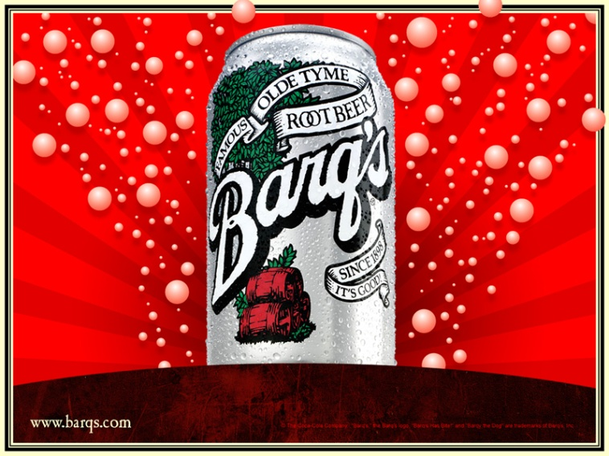
Future Work
Narrowed-down version
Population-based study
County-based study
Study on the effect of moving on one’s dialect

