Slide 1
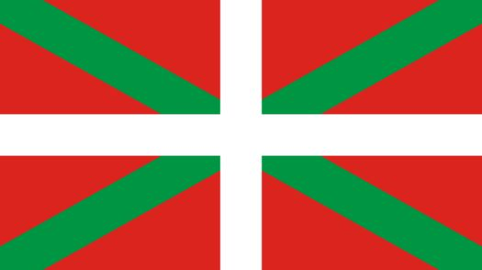
The Influence of Spanish on Basque

Slide 2
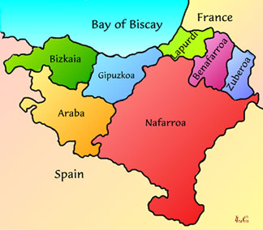
Spanish Basque
Indo-European
Italic
Romance
Italo-Western
Gallo-Iberian
Ibero-Romance
West Iberian
Spanish
Castilian
Basque

Slide 3
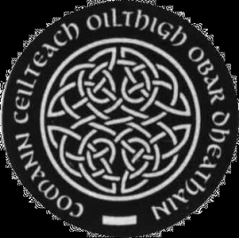
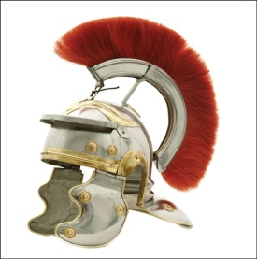



Influences on Basque over the years:
Celtic
Latin
Spanish
French
English

Slide 4



Spanish Words in Basque
          kotxe coche
          defendatu defender
          dinosaurio dinosaurio
          dorpe torpe

Slide 5
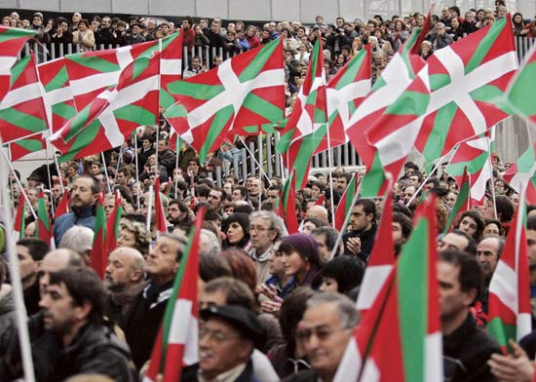
Basque Nationalism
Basque language very important in Basque Identity
Founder of Basque Nationalism: Sabino Arana; end lf 19th century
Arana’s greatest linguistic concern was to keep Basque free of loanwords
Rartiticulation of Basque nationalism under Krutwig with reverse language planning at the heart of it. Basque education in schools
Batua

Slide 6
Side 1
The number of Spanish words in Basque is increasing
Side 2
The number of Spanish words in Basque is remaining the same

Slide 7
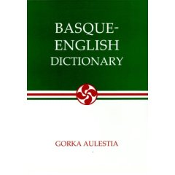
Methodology
Go through D section of Basque-English Dictionary (1932) and extract words of Spanish origin
Go through Morris Pocket Euskara-Ingelesa/English-Basque Dictionary (1998) and do the same
Identify words that aren’t found in the other
(Verify origin)
Total the number of words from each dictionary and discover if 1998 has more Spanish words

Slide 8
Analysis
113
MORE words in the 1998 dictionary

Slide 9
Problems
Individual differences of dictionaries
Verification of origins—Latin or Spanish?
Time span
Words in 1932 version not found in 1998 version

Slide 10



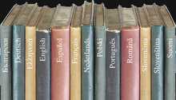
The number of Spanish words in Basque seems to be increasing
Conclusion

